Slide 1

Summit & Chitkara Hackathon
Problem statement :
>Build a co-Authoring app with dynamic UI.
UI handles multiple fields, API updates fields with multiple users simultaneously.
Users can change field values through the UI.
UI receives events on attribute updates and auto-updates.

Slide 2
Overview of the Solution
Our co-authoring app is a collaborative platform that enables multiple users to work together in real-time.
With our solution, users can seamlessly create, edit, and collaborate on documents simultaneously. The app provides a comprehensive text editor that allows users to make edits, add formatting, and insert media.
One of the standout features is the ability to add comments to specific sections of the document, facilitating discussions and feedback among collaborators. Additionally, our app keeps a detailed log of changes made by each user, ensuring transparency and accountability.

Slide 3
Technical approach for the problem
Our co-authoring app utilizes a client-server architecture to facilitate real-time collaboration among multiple users.
Our Tech Stack includes:
MongoDB
ExpressJs
ReactJs
NodeJs

Slide 4
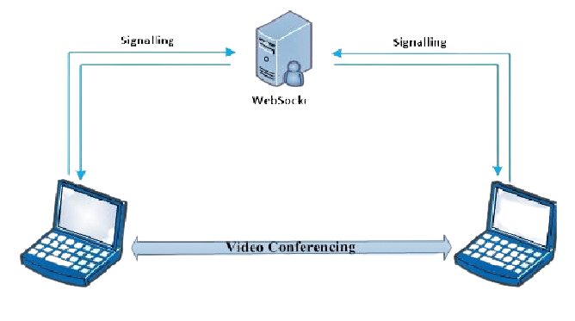
Frontend Frameworks And Libraries
On the front-end, we developed a responsive web-based interface using modern web technologies such as React.js, Quill editor, sockets, Material ui,..addmore IF POSSIBLE.
This allows users to access the app seamlessly from different devices and browsers.
Signalling
Signalling
WebSocket
Realtime-Updations

Slide 5
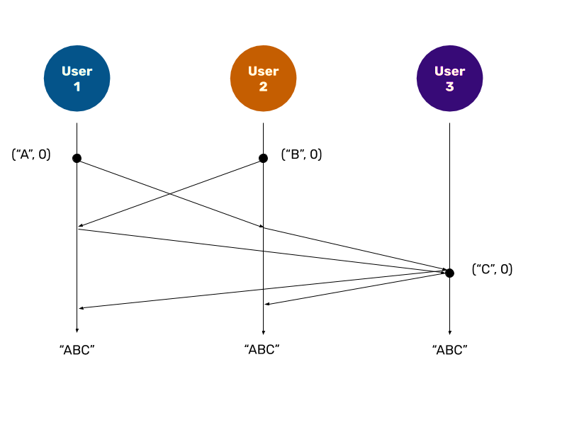
Web-Sockets And Conflict Handling
To achieve real-time collaboration, we integrated a WebSocket protocol, such as Socket.IO, to establish a bi-directional communication channel between the client and the server. This enables instantaneous updates and synchronization of changes across all connected user screens.
We implemented optimistic rendering techniques using ‘yjs’ library to handle conflicts when multiple users update a single document at the same time frame as to provide a smooth user experience, where changes are reflected to the local copies of the CRDTs (Conflict-free Replicated Data Types).
Yjs uses data structures such as logs and position trees or maps to represent the sequence of operations and their positions within the shared data structure, on the basis of which the CRDTs are broadcast to all the connected users.
This image represents the position holding of the updations done at the same time by different users and all of them being reflected to every connected user.

Slide 6
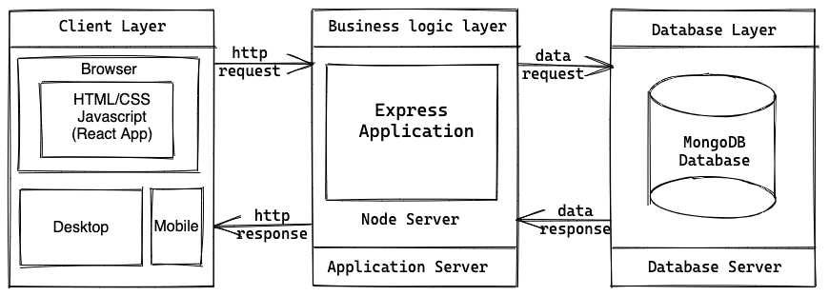
Backend Frameworks and Libraries
For the back-end, we designed a scalable and efficient server using Node.js and Express.js. This server handles the WebSocket connections, manages user authentication and authorization, and handles document persistence. We employed a database known as MongoDB, to store and retrieve user information, document metadata, and revision history.
In addition, we employed authentication and access control mechanisms to secure user data and prevent unauthorized access. Users can sign up, log in, and manage their documents with appropriate actions.
Bird eye view of the flow of data for the Webapp

Slide 7
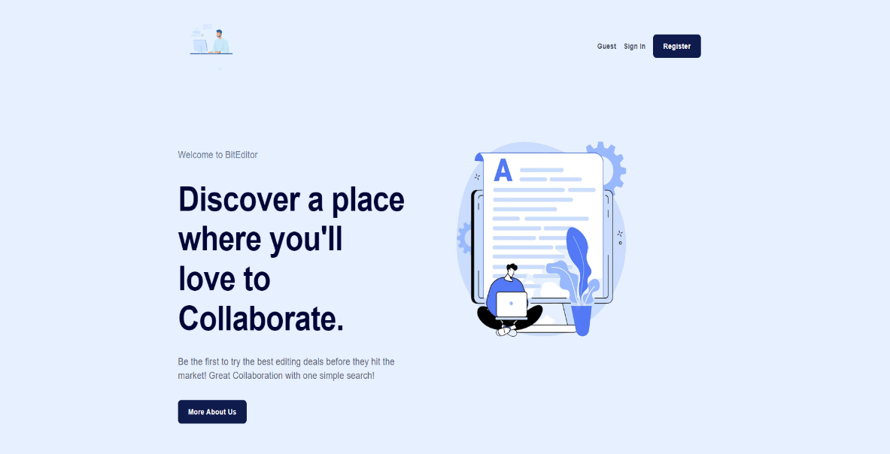
Functioning of the WebApp
Start Page:
The start page presents two buttons: Login, and Signup.
The Login button enables users to log in with their credentials.
The Signup button allows new users to create an account.
Logged-In Page:
After successful login, users are redirected to the logged-in page.
The logged-in page provides options to create a new document, view previous documents, and log out.
Creating a new document opens a text editor with additional functionalities.

Slide 8
c) Document Management:
Users can view a list of previously created documents.
The document management section allows users to delete and view their documents
Users can select and open a specific document for editing or collaboration.
d) Logout:
The logout functionality allows users to securely log out from the application.
Upon logout, users are redirected back to the start page or a landing page.

Slide 9
e) Text Editor:
The text editor enables users to create and edit documents in real-time.
Users can collaborate with others by sharing room code with them to join the document.
Real-time messaging allows users to communicate and collaborate within the text editor.
The text editor keeps track of document version history and provides access to logs.

Slide 10
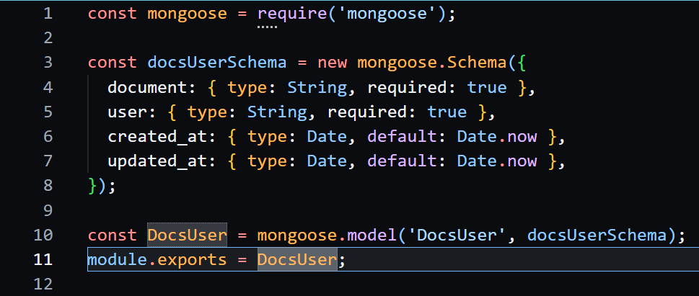
Backend Schema Overview
1.) Document-User Schema
The purpose of this schema is to establish a relationship between users and documents. By storing the ‘user’ property, the schema ensures that only specific users associated with a particular ‘document ’ can perform updates on that document. It provides a way to restrict access to document updates based on the associated user.
Additionally, this schema can facilitate communication and updates among users.
Users associated with the same document can communicate with each other or receive updates related to that document.

Slide 11
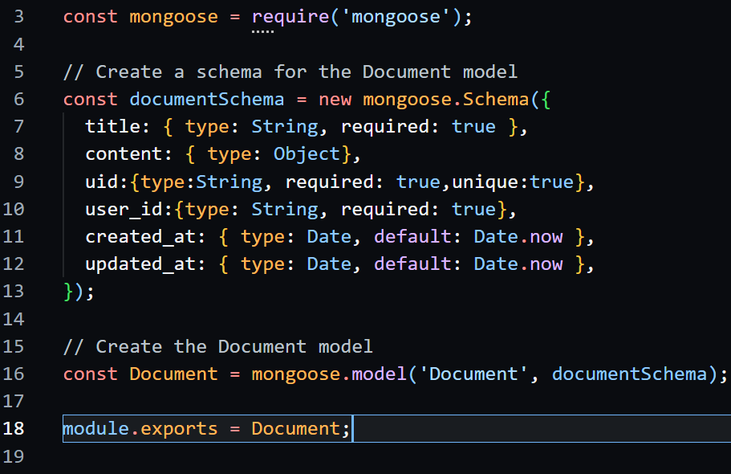
2.)Document Schema
This schema is intended for receiving data of a document to be stored, including its title, content and the id of the user who created it.
All these details help to maintain the integrity and security of the document by not allowing any other user to edit/view other user’s documents.

Slide 12
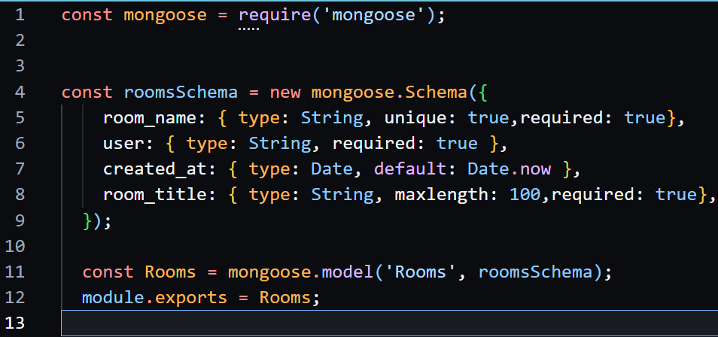
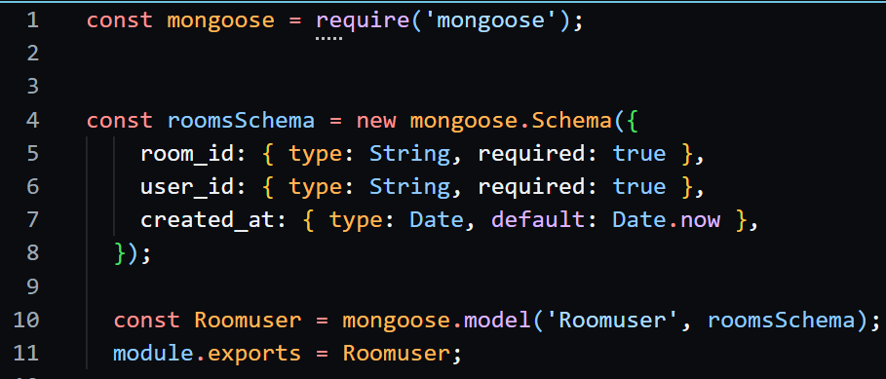
Backend Schema Overview
3.) Rooms Schema
This schema is used to store the room name and the user that has created the room.
It is used to ensure the integrity of the user that no other user is able to perform deletion of the room or share room links to anyone else
4.) Room User Schema
This schema is used for storing the room id and the user that is connected to the particular room
Only those users will be able to update/view/edit the data on the document according to their roles, whether they are admin or a normal user

